Slide 1

FORECASTING HOUSING PRICES FOR INVESTMENT OPPORTUNITIES
Akarsh Sahu | Abhi Ghose | Hazeem Abdelrehman | Rush Samal

Slide 2
Scope & Objective
Background
GOBankingRates is an interest rate information website that reaches 1 bn readers through the likes of Forbes, CNBC, Yahoo Finance
In April 2019 > Survey in 100 cities for best investment destinations > Based on 4 main variables including employment growth
Ranks of cities for investments based on survey:
#1 Miami
#2 San Francisco
#3 Los Angeles
#4 Chicago
#5 NY
Business Problem: Surveys on investment locations may not always convey the whole message. It needs some extent of extensive data analysis that can help investors to make better decisions which is lacking in this survey. Use of time series analyses can reduce the risk of investment.
Objective: a. Use time series analysis to forecast price per sqft in top 5 cities in the US (NY, LA, Chicago, Miami and SFO).
b. Compare our results with rankings from the survey for investment preferences.
Time Series Analysis Application: Time series analysis would help us in identifying appropriate models for each city under consideration and forecast housing prices accordingly.
Notes:
Across the United States, home prices are rising fast, especially because available inventory is low throughout the nation. In some cities, prices are reaching levels not seen since the before the financial crisis.
With wages remaining fairly steady, the rise in home prices is bad news for homebuyers — but good news for investors. To determine which cities are the best and worst for owning investment property — that is, owning property to rent out to tenants — GOBankingRates surveyed 67 of the 100 most populous cities in the U.S.

Slide 3


Methodology
Baseline with Holt Winters
Accuracy
Forecasting
Model
Fit
Comparison
sARIMA
Accuracy
Forecasting
Trend
Seasonality
Stationarity
Forecasting Comparison
Split:
Train
Test
ARIMA regression
Accuracy
Forecasting
Identify
Best Model
NY, LA, CH, MI, SFO
VARMA
Accuracy
Forecasting
Rank
Based on
Price & Predictability
Ensemble Model

Slide 4
Time Series Models
We ultimately settled on the four most practical model types: exponential smoothing, seasonal ARIMA models, Vector Autoregressions and Regression with ARIMA errors
We will use a training and holdout data set o execute a first pass on model evaluation for each of the models
Holt Winters
SARIMA
Vector Autoregressions
Regression with ARIMA Errors
Model Rationale:
Easy to Execute
Provide a basis to compare the other models to a smoothing function
Model Rationale:
Detectable seasonality, clear AR and sMA order in the ACF/PACF model
Intuition suggest AR model will be key to a periodic operations
Model Rationale:
Easy to estimate.
Have good forecasting capabilities.
All are endogenous that helps the researcher.
Very easy to test for Granger non-causality.
Model Rationale:
Univariate relationship between cases and distance
Model should predict the cases better with the addition of distance data, then allow errors to be handled with ARIMA.

Slide 5
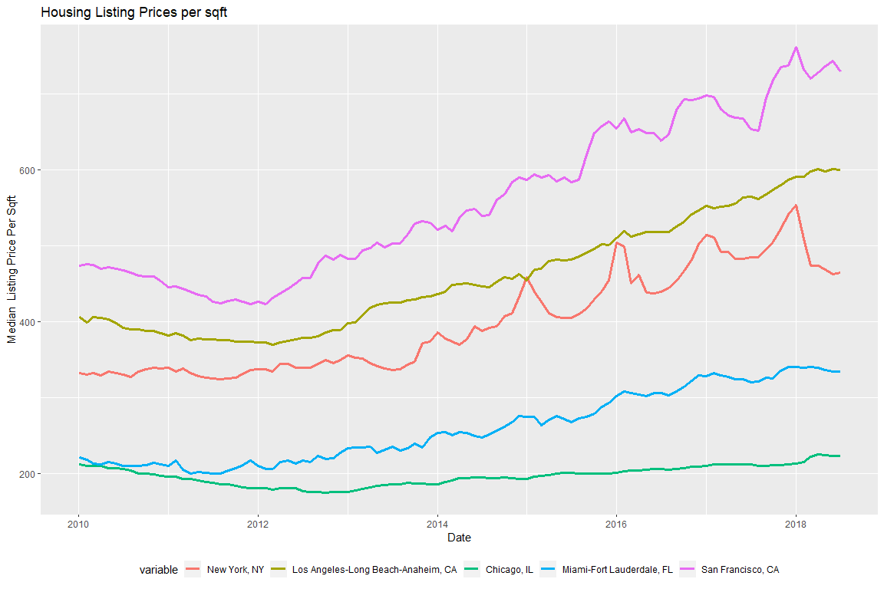
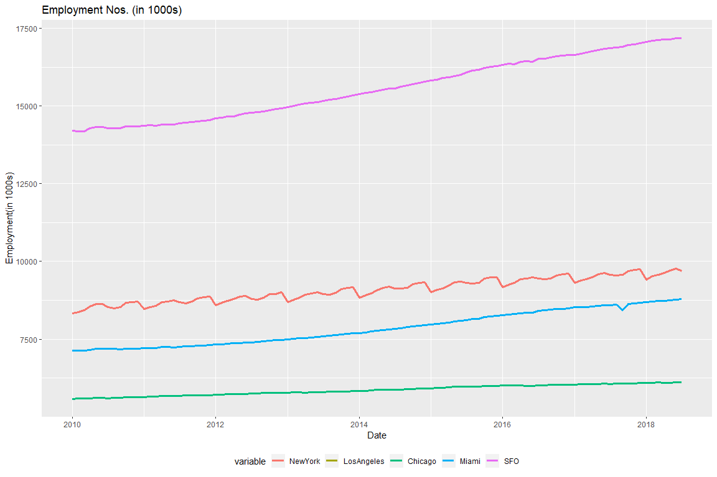
Datasets
Datasets
Metro_MedianValuePerSqft
Source: Zillow Open Dataset
Cities: NY, LA, Chicago, Miami, SFO
Employee Numbers in ‘000s
Source: Bureau of Labor Statistics
Cities: NY, LA, Chicago, Miami, SFO
 | Start | End | Frequency
Train | Jan 2010 | July 2018 | 12
Test | Aug 2018 | July 2019 | 12
 | Start | End | Frequency
Train | Jan 2010 | July 2018 | 12
Test | Aug 2018 | July 2019 | 12

Slide 6
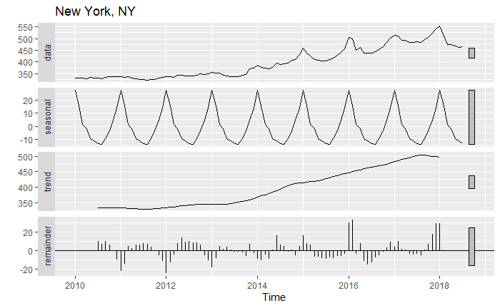
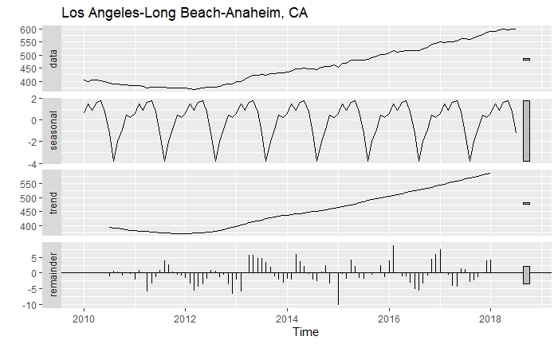
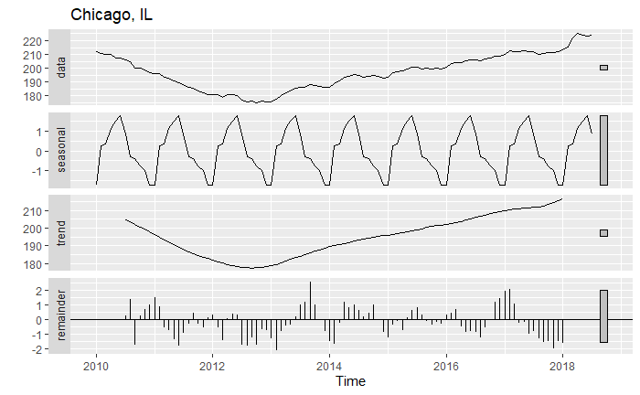
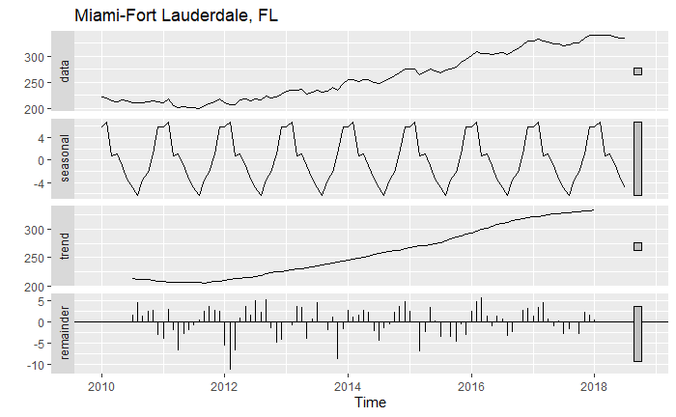
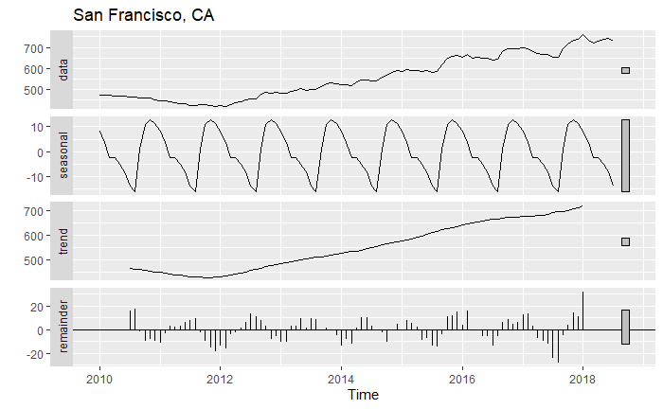
Decomposing: Additive Time Series

Slide 7
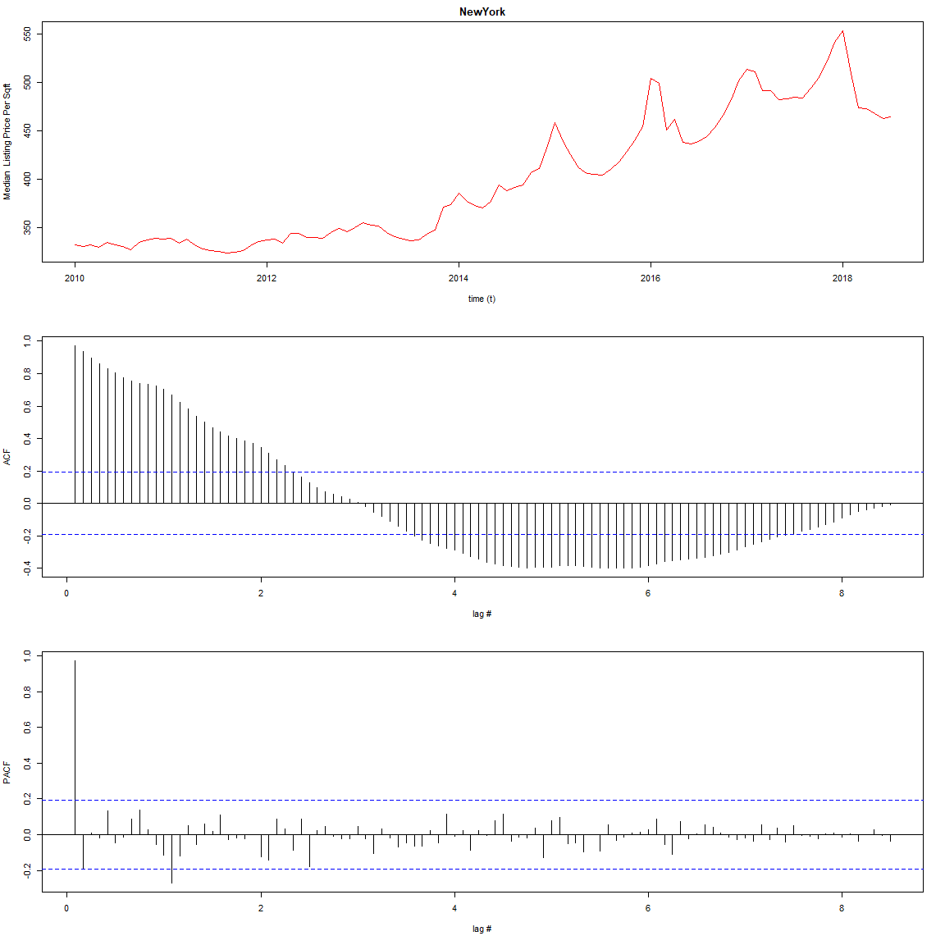
Exploratory Analysis : New York
Augmented Dickey-Fuller Test
data: ts_1_train[, i]
Dickey-Fuller = -3.1369, Lag order = 4, p-value = 0.1053
alternative hypothesis: stationary
Box-Ljung test
data: ts_1_train[, i]
X-squared = 1262.6, df = 25, p-value < 2.2e-16
Augmented Dickey-Fuller Test
data: diff(ts_1[, 1])
Dickey-Fuller = -5.9653, Lag order = 4, p-value = 0.01
alternative hypothesis: stationary

Slide 8
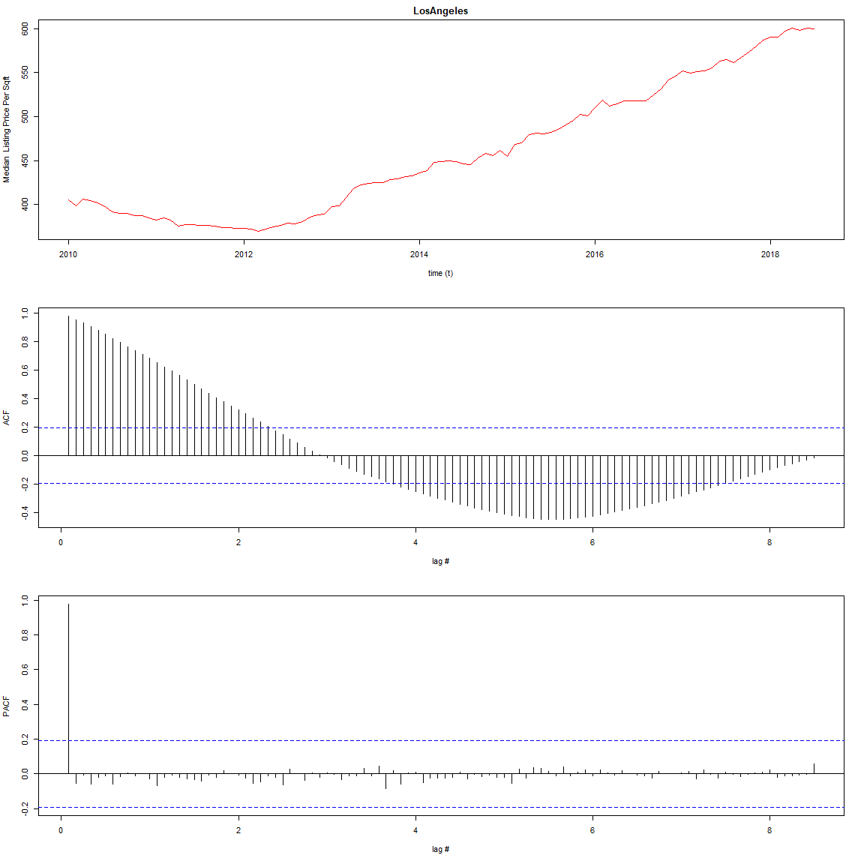
Exploratory Analysis : Los Angeles
Augmented Dickey-Fuller Test
data: ts_1_train[, i]
Dickey-Fuller = -3.9372, Lag order = 4, p-value = 0.01494
alternative hypothesis: stationary
Box-Ljung test
data: ts_1_train[, i]
X-squared = 1322.4, df = 25, p-value < 2.2e-16
Augmented Dickey-Fuller Test
data: diff(ts_1[, 2])
Dickey-Fuller = -3.7851, Lag order = 4, p-value = 0.02216
alternative hypothesis: stationary

Slide 9
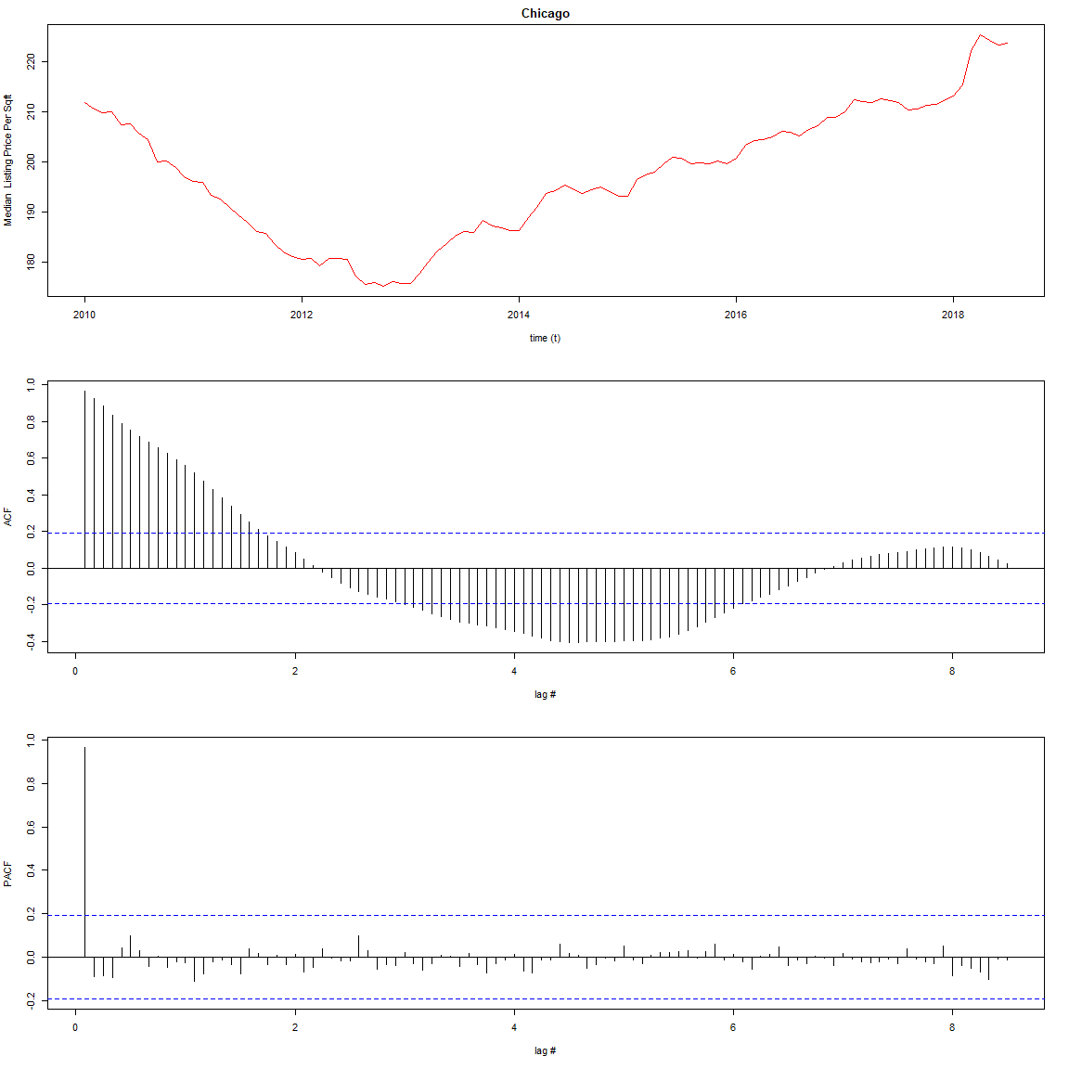
Exploratory Analysis: Chicago
Augmented Dickey-Fuller Test
data: ts_1_train[, i]
Dickey-Fuller = -2.7003, Lag order = 4, p-value = 0.2863
alternative hypothesis: stationary
Box-Ljung test
data: ts_1_train[, i]
X-squared = 917.43, df = 25, p-value < 2.2e-16
Augmented Dickey-Fuller Test
data: diff(ts_1[, 3], differences = 2)
Dickey-Fuller = -6.1103, Lag order = 4, p-value = 0.01
alternative hypothesis: stationary

Slide 10
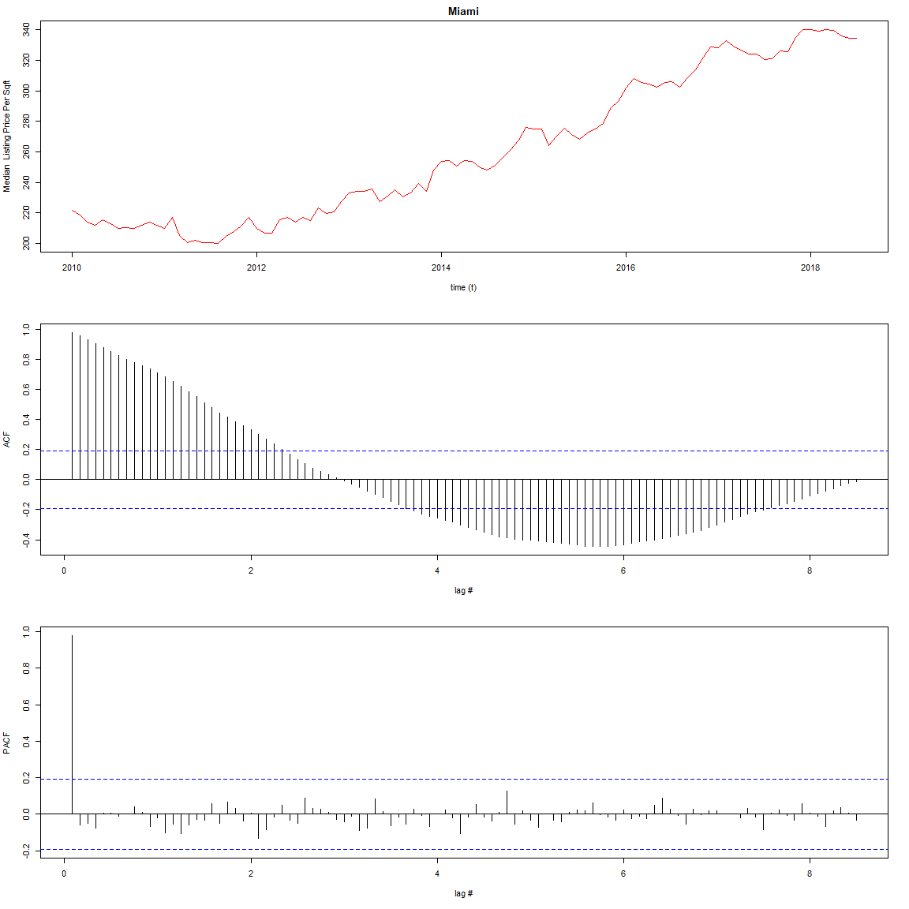
Exploratory Analysis : Miami
Augmented Dickey-Fuller Test
data: ts_1_train[, i]
Dickey-Fuller = -3.2276, Lag order = 4, p-value = 0.08701
alternative hypothesis: stationary
Box-Ljung test
data: ts_1_train[, i]
X-squared = 1376.9, df = 25, p-value < 2.2e-16
Augmented Dickey-Fuller Test
data: diff(ts_1[, 4])
Dickey-Fuller = -5.2693, Lag order = 4, p-value = 0.01
alternative hypothesis: stationary

Slide 11
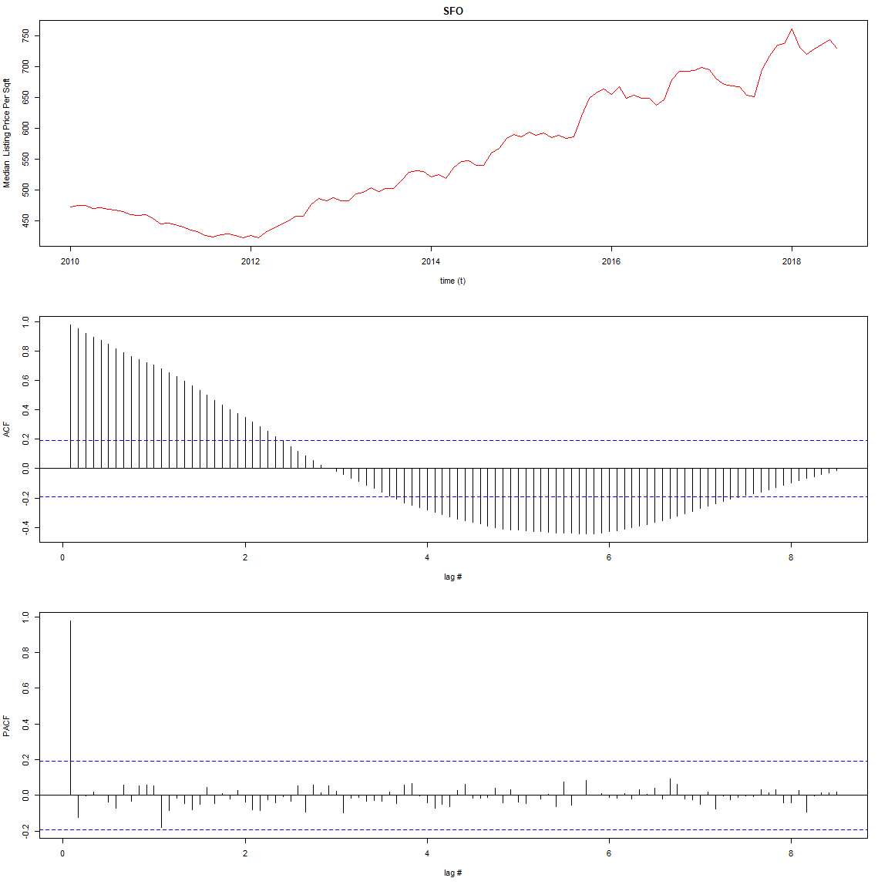
Exploratory Analysis : San Francisco
Augmented Dickey-Fuller Test
data: ts_1_train[, i]
Dickey-Fuller = -3.3277, Lag order = 4, p-value = 0.07033
alternative hypothesis: stationary
Box-Ljung test
data: ts_1_train[, i]
X-squared = 1367.3, df = 25, p-value < 2.2e-16
Augmented Dickey-Fuller Test
data: diff(ts_1[, 5])
Dickey-Fuller = -5.3628, Lag order = 4, p-value = 0.01
alternative hypothesis: stationary

Slide 12
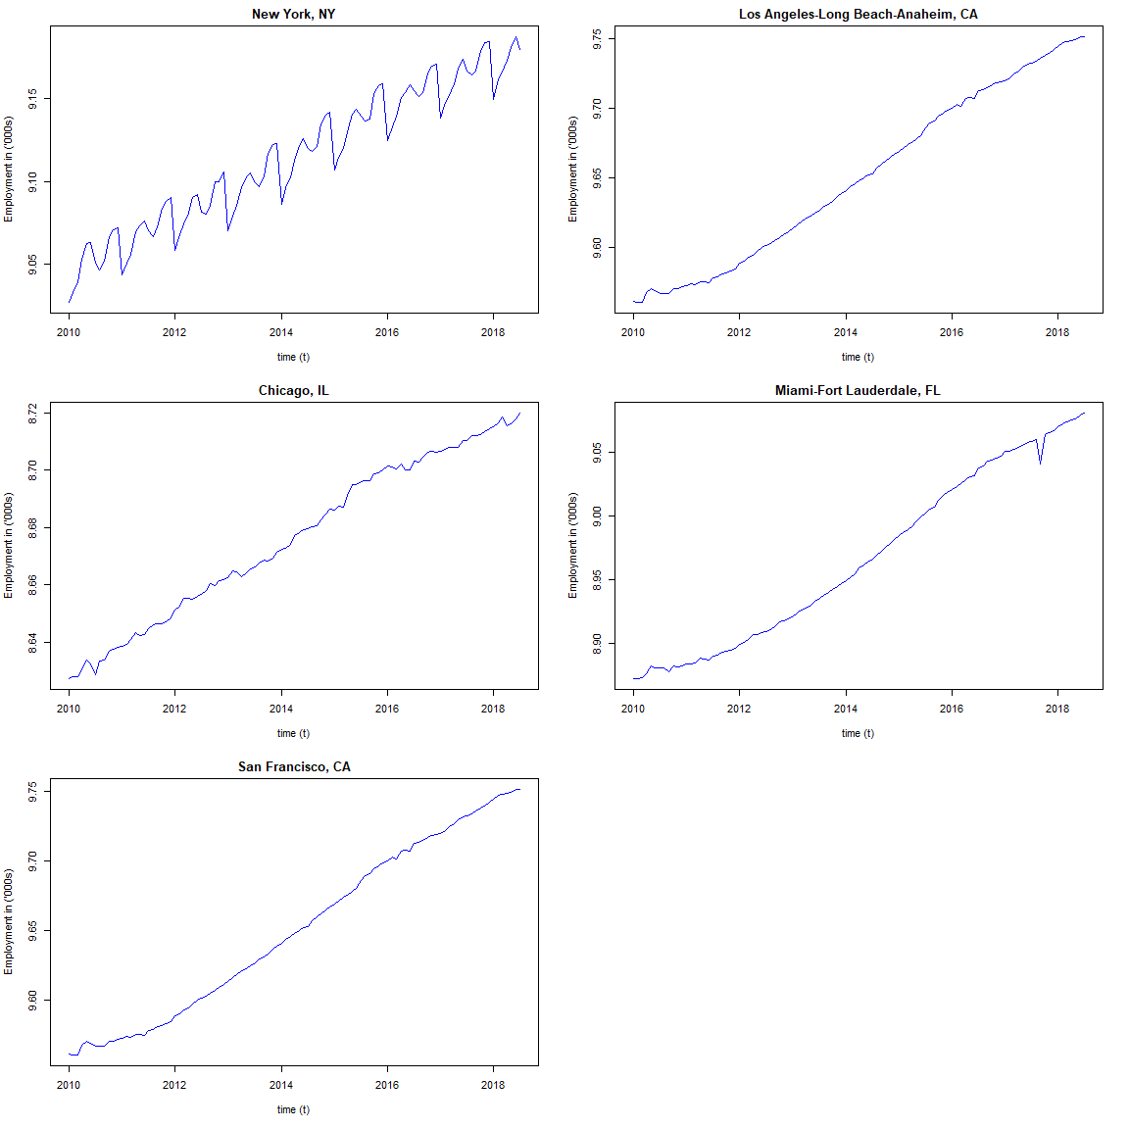
Box-Cox Test
Key Observations:
Box Cox Lambda = 0 or log transformation helps stabilize the variance in employment timeseries to a high extent.
In the next slide, we test the log transformation on the response time series.

Slide 13
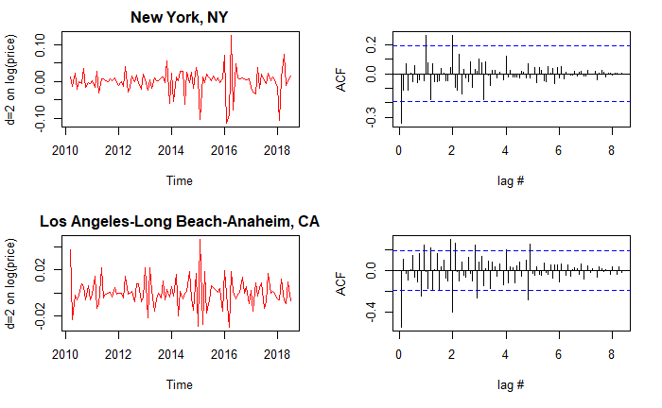
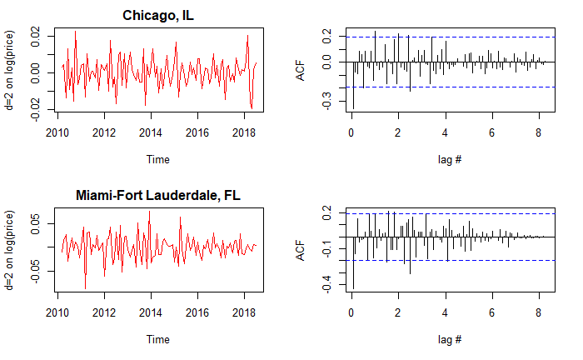
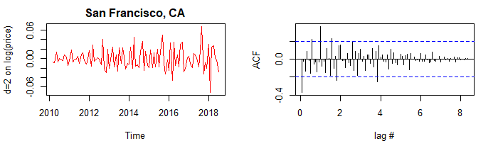
Differencing with log
Key Observations:
With differencing of order 2 we can achieve stationarity for all metros.
On manual trial and error we found that some cities may not require differencing order of 2 rather 1 should be good.
Taking log on the trends has reduced the variance to a very high extent

Slide 14
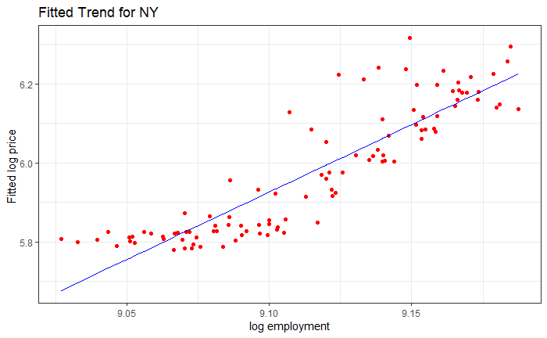
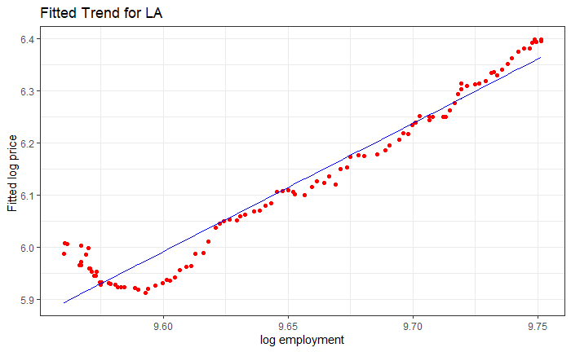
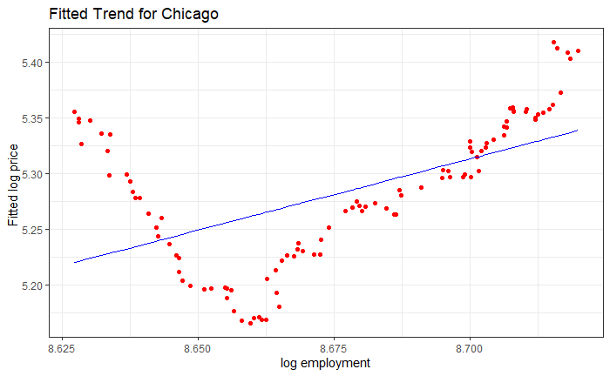
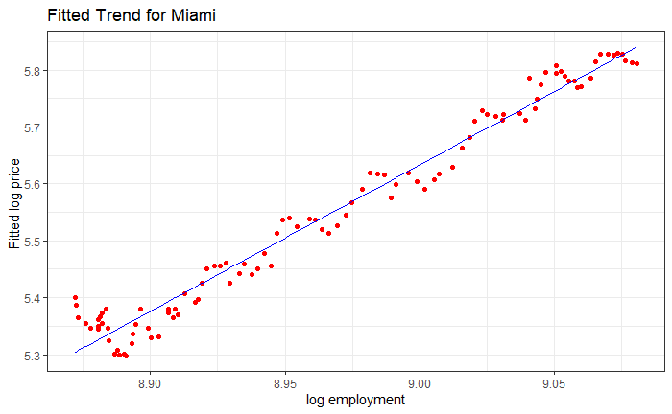
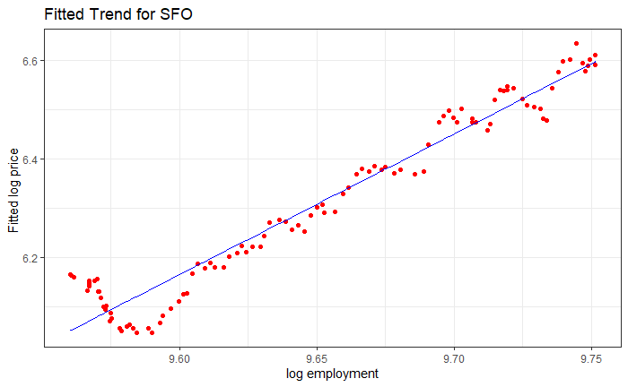
Correlation of Price/Sqft vs Employment
Corr: 0.88
Corr: 0.97
Corr: 0.56
Key Observations:
There is high correlation between employment numbers and median price per sqft
Linear model does not fit ts of all cities accurately, eg: NY, CH
Corr: 0.98
Corr: 0.97

Slide 15
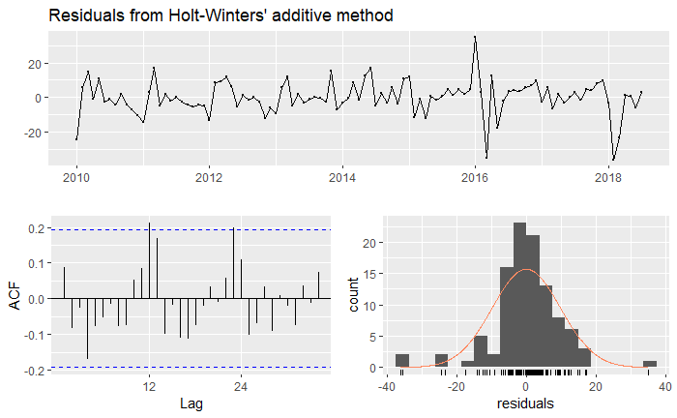
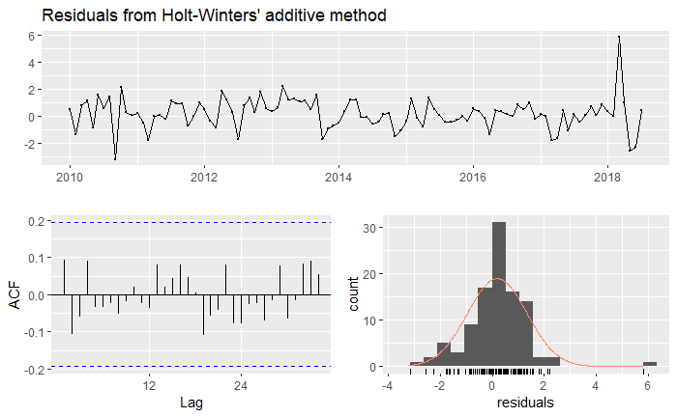
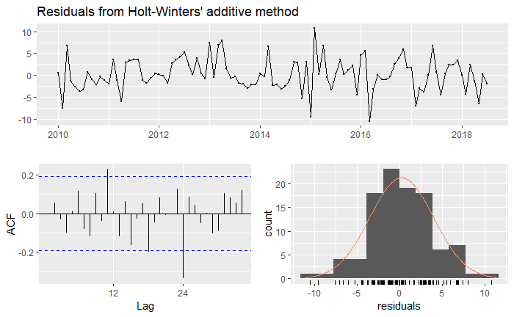
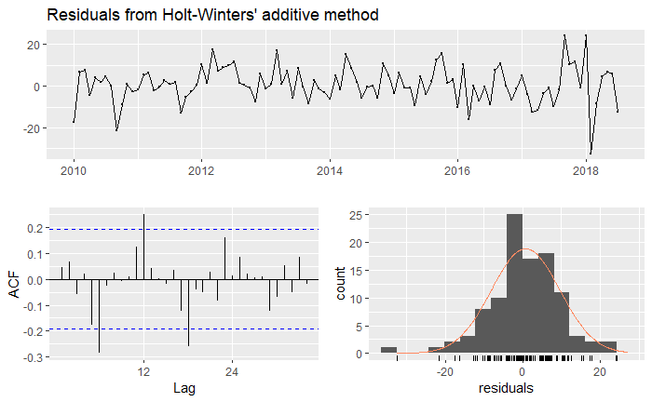
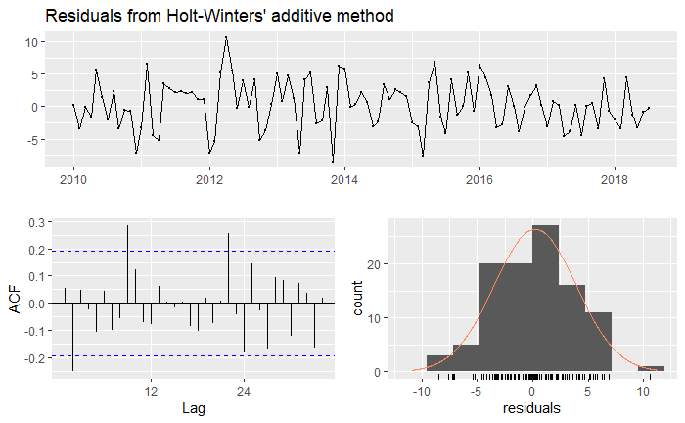
Model Holt-Winter Additive
NY
LA
CH
MI
SF
Metro | Ljung Box p-values | Coefficients
NY | 0.0004376 | alpha = 0.9985 beta = 9e-04 gamma = 4e-04
LA | 0.0001111 | alpha = 0.8367 beta = 0.1103 gamma = 1e-04
CH | 0.1226 | alpha = 0.9999 beta = 0.134 gamma = 1e-04
MI | 6.873e-05 | alpha = 0.7922 beta = 0.0551 gamma = 1e-04
SF | 1.632e-06 | alpha = 0.9998 beta = 0.0562 gamma = 1e-04

Slide 16
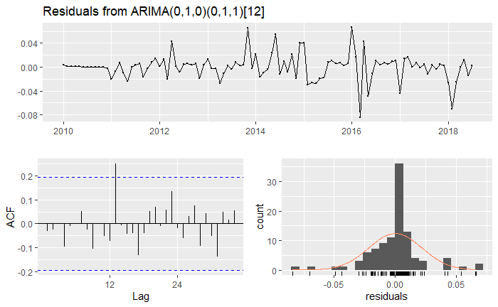
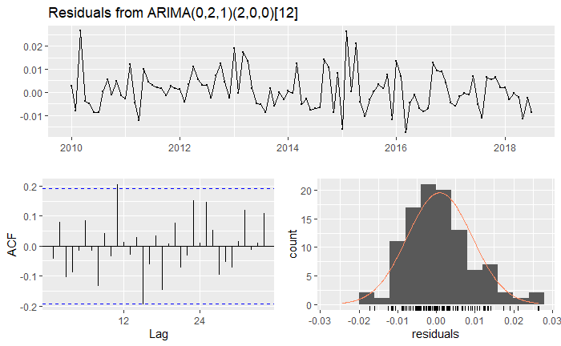
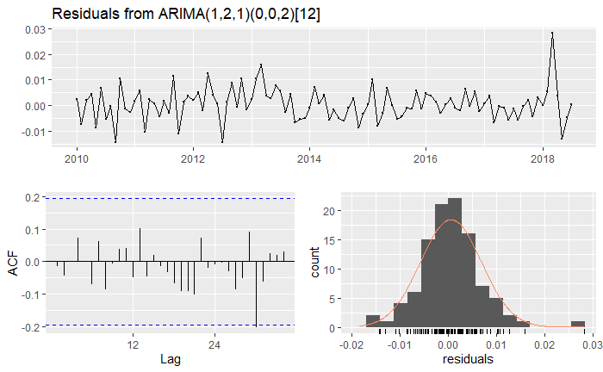
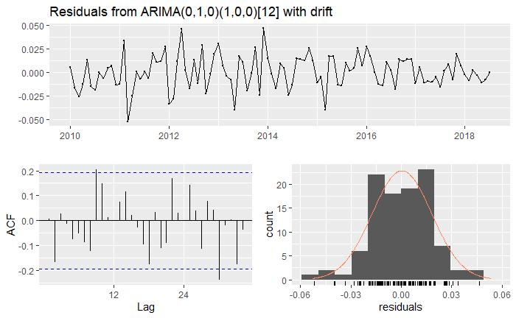
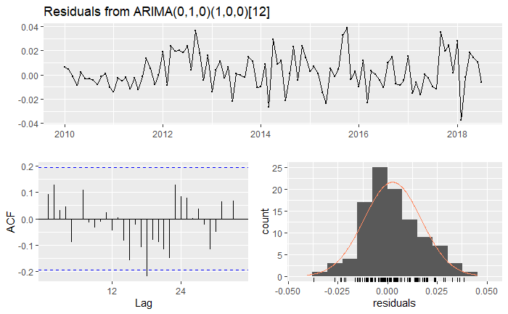
Model sARIMA
NY
LA
CH
MI
SF
Metro | Ljung Box p-values | Coefficients
NY | 0.7682 | sma1 -0.5497
LA | 0.2861 | ma1 sar1 sar2 -0.87 0.085 -0.3
CH | 0.9339 | ar1 ma1 sma1 sma2 0.25 -0.92 0.38 0.33
MI | 0.1793 | sar1 drift 0.25 0.004
SF | 0.4115 | sar1 0.61

Slide 17
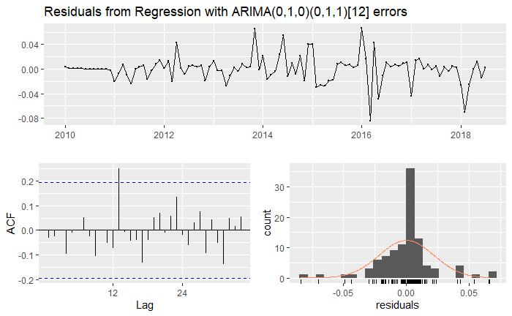
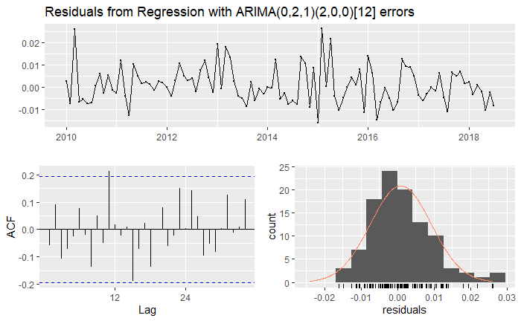
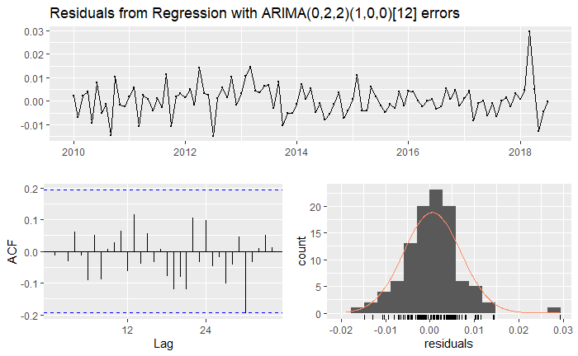
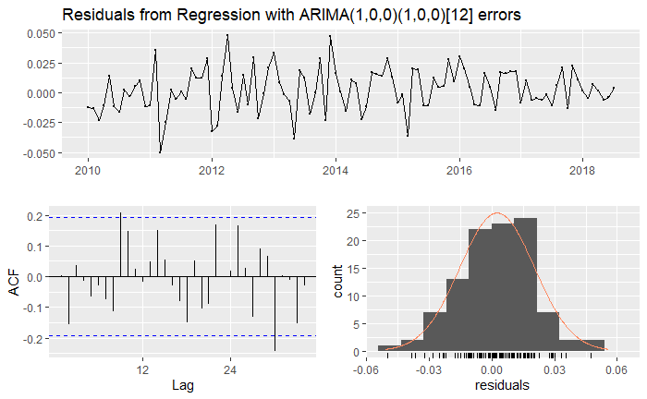
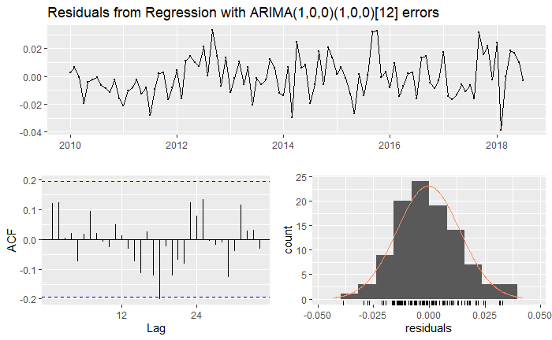
Model ARIMA Reg with errors
NY
LA
CH
MI
SF
Metro | Ljung Box p-values | Coefficients
NY | 0.7135 | sma1 xreg -0.5496 0e+00
LA | 0.2321 | ma1 sar1 sar2 xreg -0.9 0.09 -0.3 0.0
CH | 0.8294 | ma1 ma2 sar1 xreg -0.7 -0.2 0.4 0
MI | 0.1439 | ar1 sar1 intercept xreg 0.9 0.3 5.2 0
SF | 0.431 | ar1 sar1 intercept xreg 0.9 0.6 4 2e-04

Slide 18
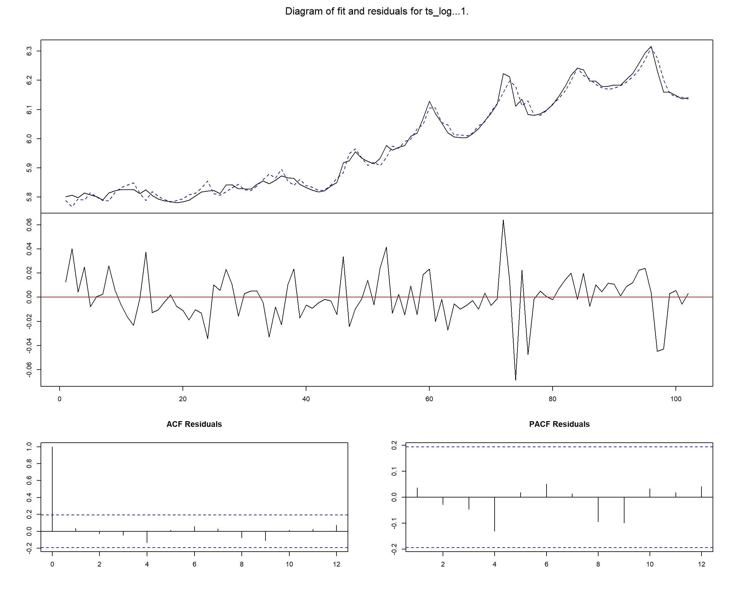
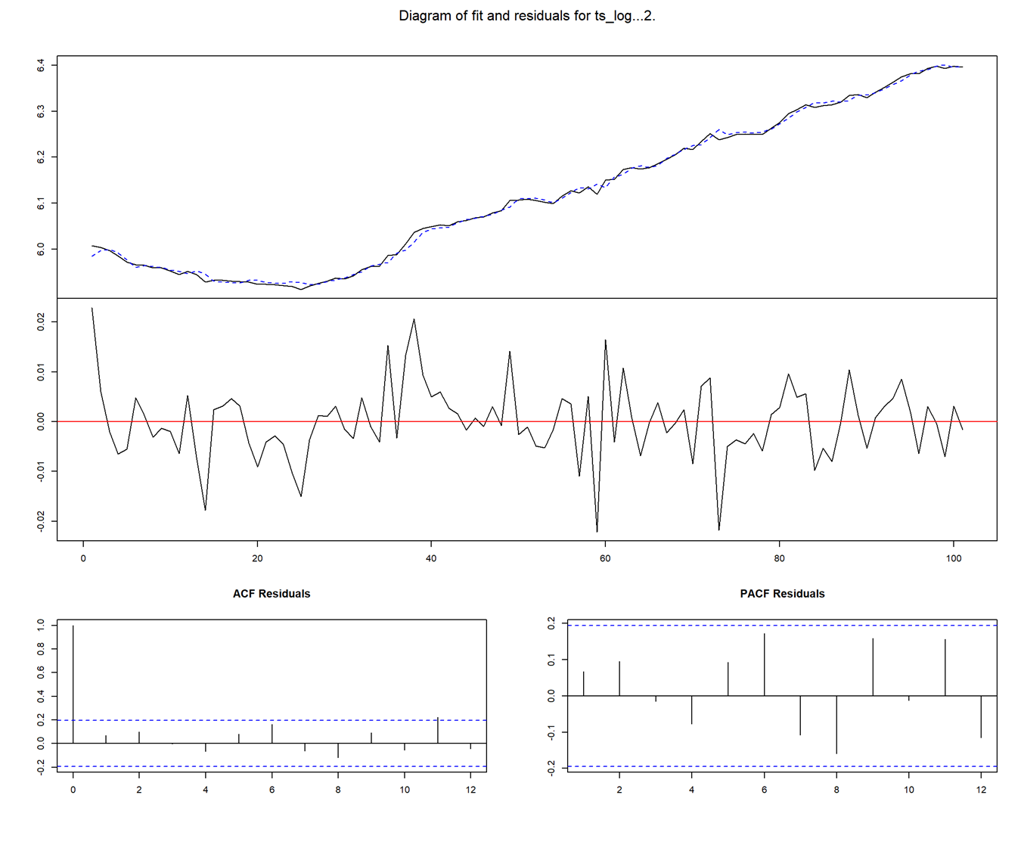
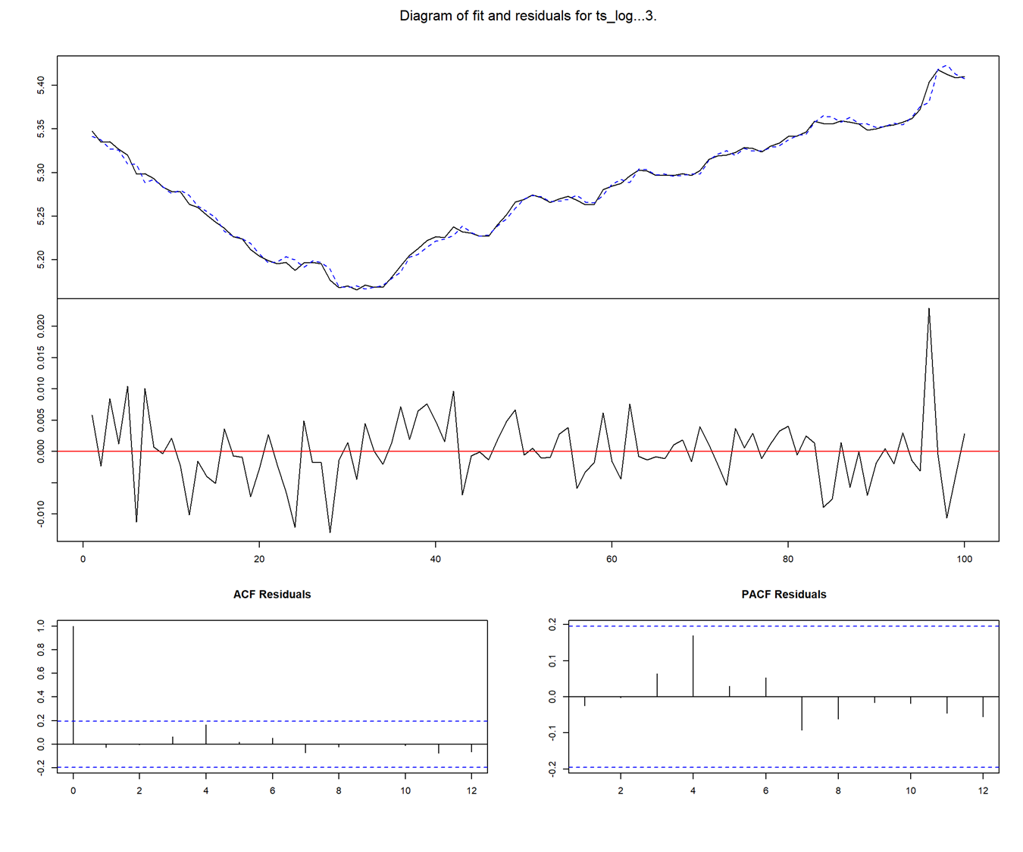
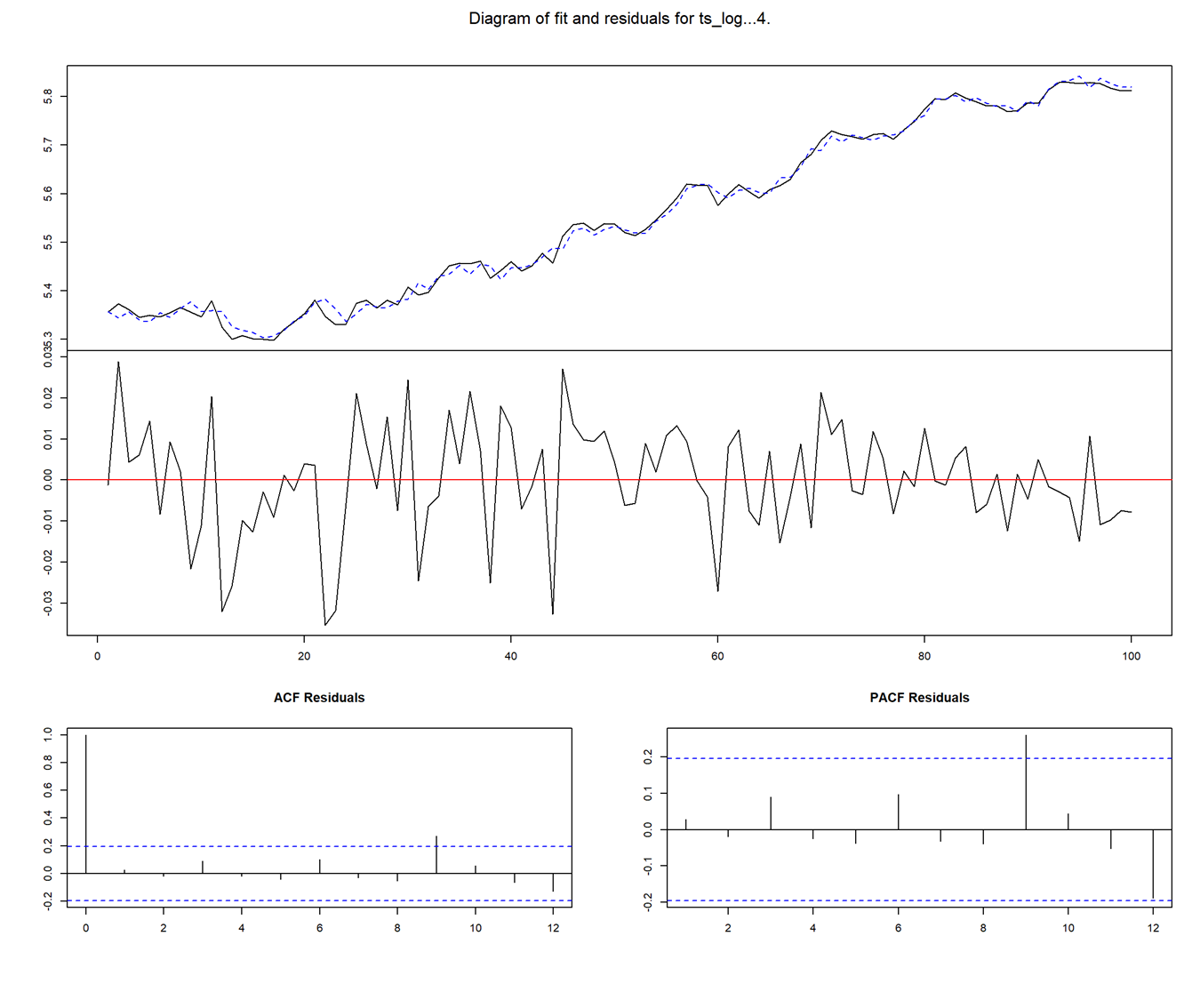
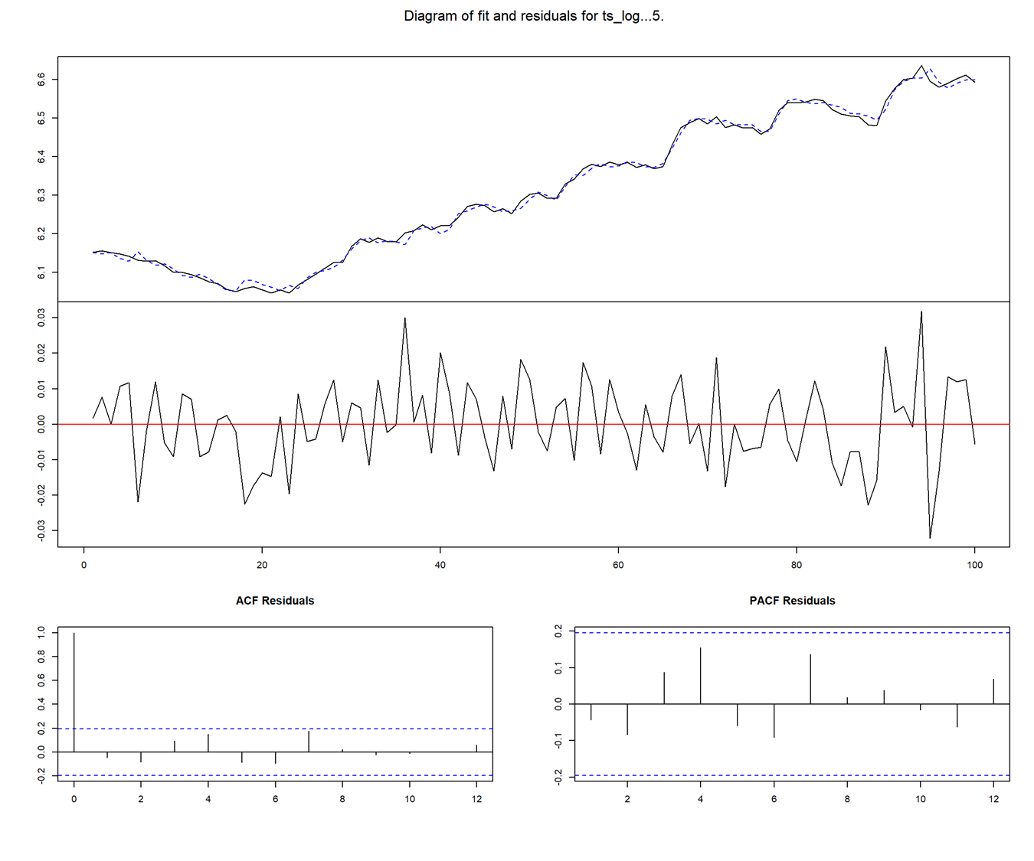
Model VAR
NY
LA
CH
Metro | Portmanteau Test p-values | 1st Order Coefficient for Employee Numbers
NY | 0.8317 | 2.29
LA | 0.3749 | 0.98
CH | 0.646 | 0.09
MI | 0.9265 | 0.96
SF | 0.5566 | 1.99
MI
SF

Slide 19
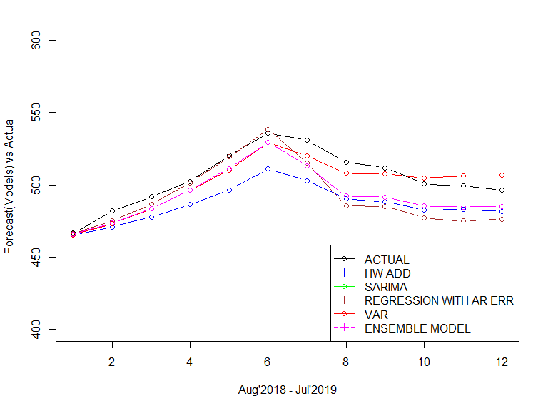
Model Comparisons: New York
Model Fit | AIC | BIC
HW ADDITIVE | 980.35 | 1025.14
SARIMA | -415.44 | -410.44
REGRESSION WITH AR ERR | -413.44 | -405.94
VAR | -1458.5 | -1379.75
Forecast Accuracy | ME | RMSE | MAE | MPE | MAPE
HW ADDITIVE | 18.12 | 19.48 | 18.12 | 3.54 | 3.54
SARIMA | 12.73 | 17.13 | 13.18 | 2.52 | 2.60
REGRESSION WITH AR ERR | 12.73 | 17.13 | 13.17 | 2.52 | 2.60
VAR | 3.52 | 7.52 | 7.03 | 0.68 | 1.39
ENSEMBLE | 11.77 | 13.34 | 11.77 | 2.31 | 2.31
* Model selection based on RMSE and MAPE

Slide 20
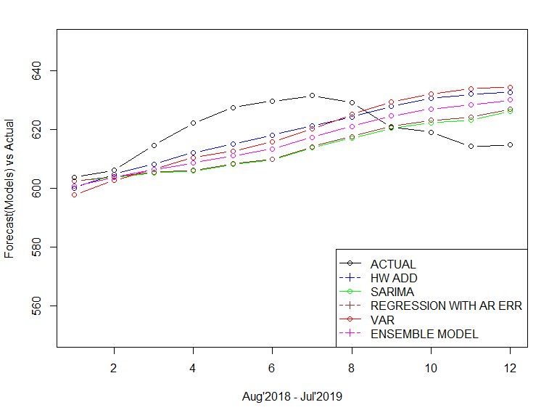
Model Comparisons: Los Angeles
Model Fit | AIC | BIC
HW ADDITIVE | 783.19 | 827.98
SARIMA | -667.23 | -656.77
REGRESSION WITH AR ERR | -666.03 | -652.96
VAR | -1691.38 | -1602.47
Forecast Accuracy | ME | RMSE | MAE | MPE | MAPE
HW ADDITIVE | 0.56 | 10.57 | 9.56 | 0.08 | 1.54
SARIMA | 6.28 | 12.28 | 10.20 | 1.00 | 1.63
REGRESSION WITH AR ERR | 5.84 | 12.25 | 10.24 | 0.93 | 1.64
VAR | 1.04 | 12.29 | 11.15 | 0.16 | 1.80
ENSEMBLE | 3.43 | 11.54 | 10.27 | 0.54 | 1.65
* Model selection based on RMSE and MAPE

Slide 21
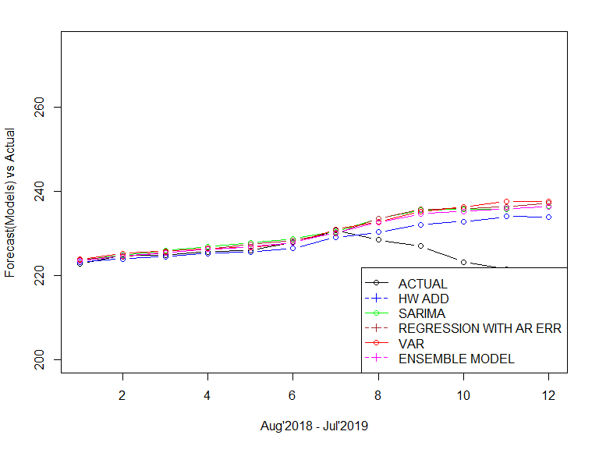
Model Comparisons: Chicago
Chicago | AIC | BIC
HW ADDITIVE | 541.25 | 586.04
SARIMA | -721.50 | -708.42
REGRESSION WITH AR ERR | -719.24 | -706.16
VAR | -1753.82 | -1654.82
Chicago | ME | RMSE | MAE | MPE | MAPE
HW ADDITIVE | -3.24 | 6.41 | 4.08 | -1.46 | 1.83
SARIMA | -5.25 | 7.95 | 5.30 | -2.36 | 2.37
REGRESSION WITH AR ERR | -5.18 | 8.17 | 5.33 | -2.33 | 2.39
VAR | -5.33 | 8.40 | 5.34 | -2.40 | 2.40
ENSEMBLE | -4.75 | 7.70 | 4.88 | -2.14 | 2.19
* Model selection based on RMSE and MAPE

Slide 22
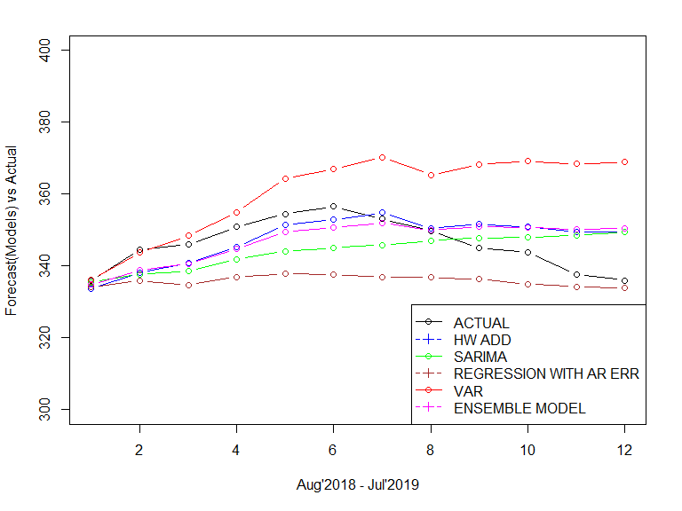
Model Comparisons: Miami
Model Fit | AIC | BIC
HW ADDITIVE | 780.88 | 825.67
SARIMA | -526.14 | -518.26
REGRESSION WITH AR ERR | -520.81 | -507.64
VAR | -1408.49 | -1309.49
Forecast Accuracy | ME | RMSE | MAE | MPE | MAPE
HW ADDITIVE | -1.28 | 6.75 | 5.63 | -0.39 | 1.64
SARIMA | 2.02 | 8.21 | 7.25 | 0.55 | 2.09
REGRESSION WITH AR ERR | 10.26 | 11.66 | 10.26 | 2.93 | 2.93
VAR | -14.28 | 18.22 | 14.41 | -4.15 | 4.19
ENSEMBLE | -0.82 | 7.14 | 5.87 | -0.27 | 1.71
* Model selection based on RMSE and MAPE

Slide 23
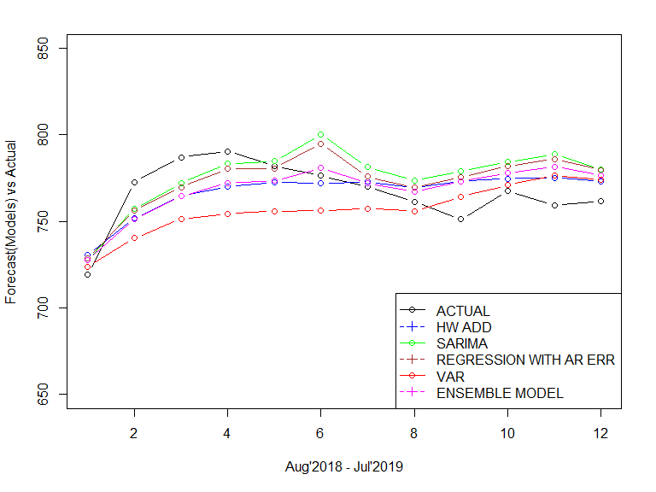
Model Comparisons: San Francisco
Model Fit | AIC | BIC
HW ADDITIVE | 959.56 | 1004.35
SARIMA | -563.59 | -558.34
REGRESSION WITH AR ERR | -567.68 | -554.50
VAR | -1576.49 | -1477.49
Forecast Accuracy | ME | RMSE | MAE | MPE | MAPE
HW ADDITIVE | -0.17 | 14.68 | 13.05 | -0.06 | 1.70
SARIMA | -9.44 | 17.56 | 15.73 | -1.25 | 2.06
REGRESSION WITH AR ERR | -6.69 | 15.91 | 14.23 | -0.90 | 1.86
VAR | 9.76 | 21.45 | 18.21 | 1.23 | 2.35
ENSEMBLE | -1.64 | 15.30 | 13.44 | -0.24 | 1.75
* Model selection based on RMSE and MAPE

Slide 24
Conclusion
Low Risk | Median forecast price/sqft | Mean monthly price increase | Standard deviation in fluctuation | Rank | Gobankingrates ranking
LA | $615 | 0.43% | 0.14 | 1 | 3
CH | $229 | 0.50% | 0.32 | 2 | 4
MI | $350 | 0.41% | 0.62 | 3 | 1
SF | $772 | 0.60% | 1.22 | 4 | 2
NY | $506 | 0.79% | 1.96 | 5 | 5
Key Observations:
We have ranked cities for investment based on 2 profiles – Low Risk and High Risk.
Each profile considers 3 basic metrics:
median forecasted price/sqft
mean monthly price increase
standard deviation in price fluctuations
From our results, it looks like gobankingrates rankings are more inclined towards high risk investors than low risk investors. The standard deviation in price change is high for SF and NY compared to those for cities Miami, Chicago and Los Angeles.
Also, the returns seem to be higher in that order suggesting these rankings fall into the high risk high gain category.
High Risk | Median forecast price/sqft | Mean monthly price increase | Standard deviation in fluctuation | Rank | Gobankingates ranking
NY | $506 | 0.79% | 1.96 | 1 | 5
SF | $772 | 0.60% | 1.22 | 2 | 2
MI | $350 | 0.41% | 0.62 | 3 | 1
CH | $229 | 0.50% | 0.32 | 4 | 4
LA | $615 | 0.43% | 0.14 | 5 | 3

Slide 25
Learnings & Future Work
A single ts model cannot forecast for all cities, each city may need a separate forecasting method
Linear model will not always fit the response data for use in arima with regression. There could be other methods of regression to use.
A larger dataset can help to have a reliable and longer forecast for up to 3 or 5 years -> enough period to change investment climate of a city
If the predictor and response variable are highly correlated, the coefficient of predictor may not be of much use
Multiple predictors such as disposable income, weather entities, gdp of the state etc. could be used for better forecast
Survey data and analytics differ a lot in terms of giving a true picture of market sentiments. For best results utilizing both could help.

Slide 26

The seeds of civilization are in every culture, but it is city life that brings them to fruition
– Susanne Katherine Langer
Writer, philosopher

